Slide 1
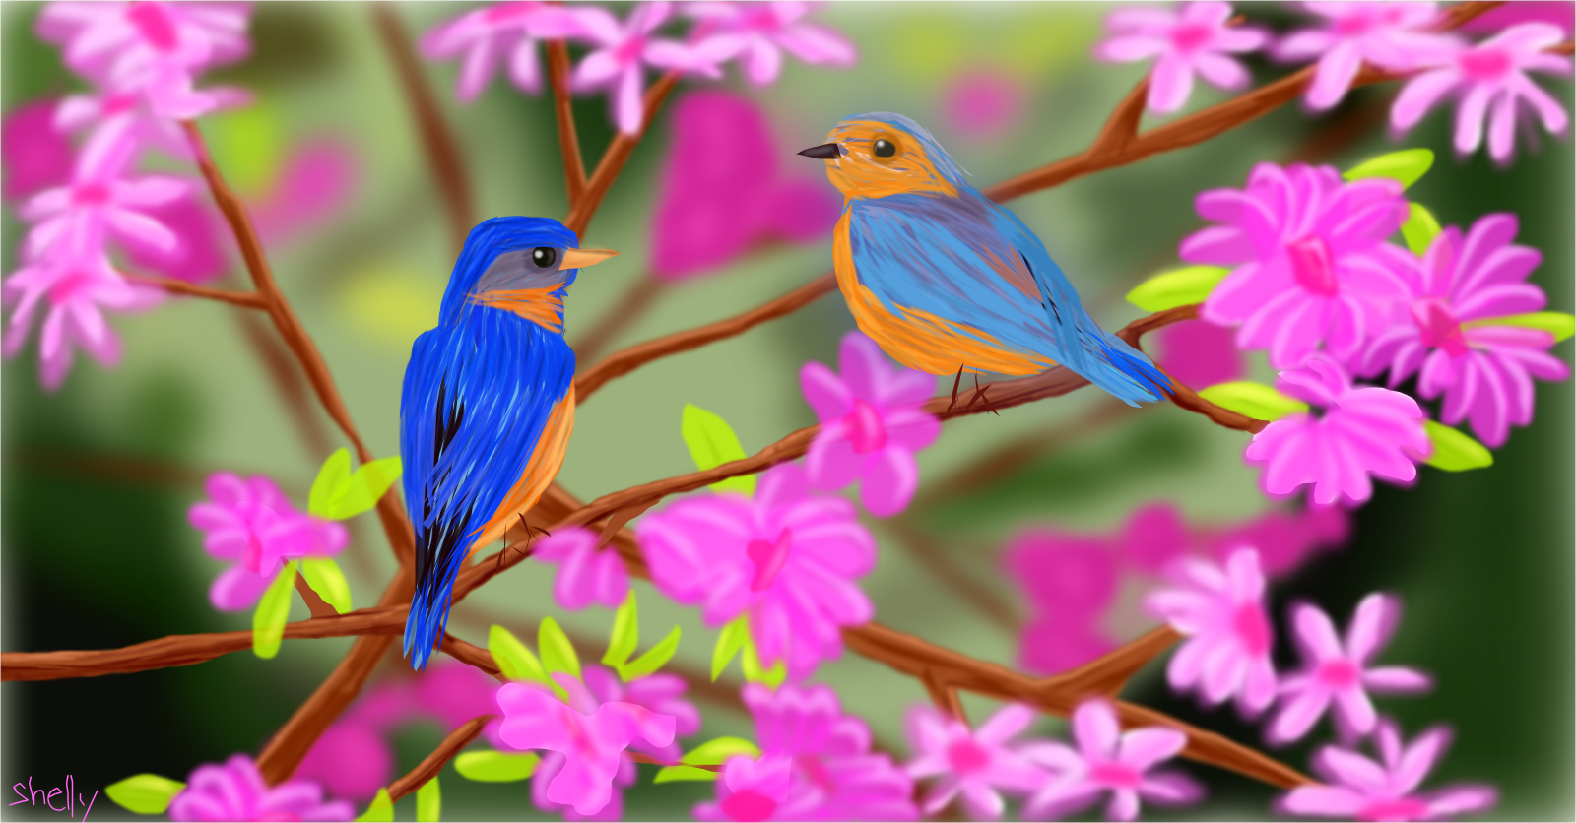
Spring Time Fun!
JFK Consultant

Slide 2
Can you remember any animal sounds from last week?

Slide 3
Can you look outside and tell me what you see?
Infants: As you hold your baby explain to them what you see outside. Tell them the trees are blooming, and the flowers are starting to bloom. Talk about how the weather is getting warmer. Tell them the birds are chirping ,and singing spring songs.
Toddlers: Have the child look outside at the trees and tell you all the different things they see.

Slide 4
Things you might see in

Slide 5
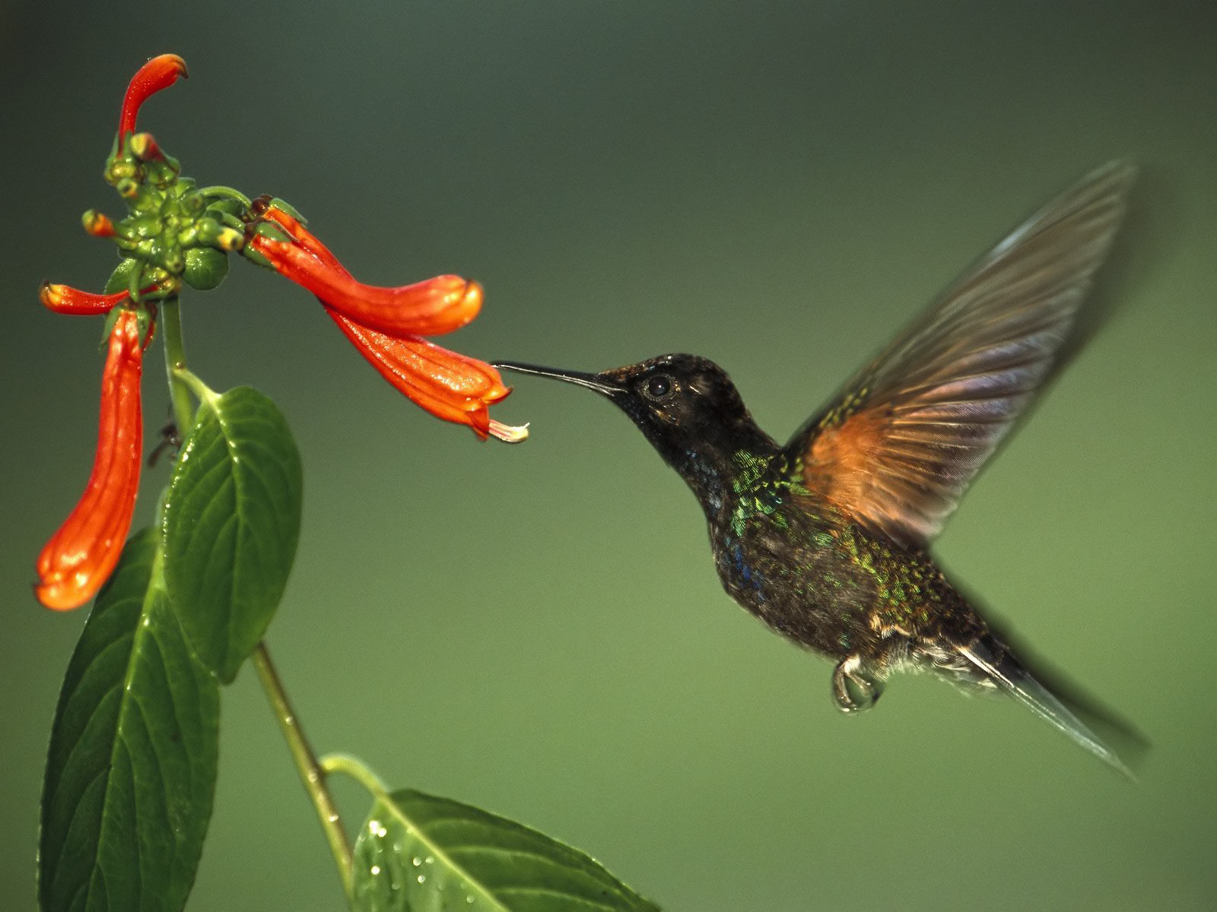
Birds

Slide 6
Flowers

Slide 7
Bunnies

Slide 8
Butterflies

Slide 9
Bugs

Slide 10
Bug, Bugs, Bugs
https://www.youtube.com/watch?v=Y5e6o8BYF-U

Slide 11
Family Activity

Slide 12
Gross Motor
Infants: Place your baby on his/her tummy. Have them try to move like a caterpillar.
*This will help with the crawling stage.
Toddlers: You and your child play like you are the animals in the book. For example:
Butterfly: Use your arms to pretend you are flying.
Caterpillar: Get on your tummies and scoot like a caterpillar.
Bunny: Hop like a bunny
Bee: Buzzy like a bee around the house.

Slide 13
Spring is Here!
https://www.youtube.com/watch?v=DobrRgD5aOU

Slide 14
Calming your child.
The link below is, “Spa” music. Play this link and it will calm you and your child.
https://www.youtube.com/watch?v=lFcSrYw-ARY

Slide 15
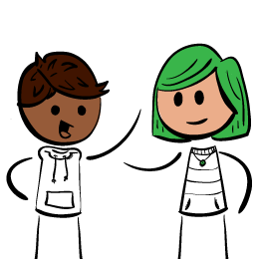
Table Talk
Mom/Dad is everything ok?
Is the baby/toddler sleeping on schedule?
Is the baby/toddler eating on schedule?
Is there anything the program can help with?

Slide 16
Additional Resources
https://www.youtube.com/watch?v=XECtg0w_YKk
Five Little Ducks
https://www.youtube.com/watch?v=TbKI-jjpPx8
Itsy Bitsy Spider and more

Slide 17
References
YouTube:
https://www.youtube.com/watch?v=XECtg0w_YKk
Five Little Ducks
https://www.youtube.com/watch?v=TbKI-jjpPx8
Itsy Bitsy Spider and more
https://www.youtube.com/watch?v=lFcSrYw-ARY
Spa Music
https://www.youtube.com/watch?v=Y5e6o8BYF-U
Bugs, Bugs, Bugs
https://www.youtube.com/watch?v=DobrRgD5aOU
Spring is Here

